Slide 1



What is Twese?
An Organization for Africans and Friends of Africa. Since its establishment in 1991, it serves as a rich source for exploration and appreciation of African culture
The word Twese comes from the Kinya-Rwanda meaning of “UNITY”.
The focus of our organization is creating a safe space and comfort zone for our Africans students and our friends of Africa as well here at Rutgers.
We currently meet biweekly from 7:30-8:45pm on Wednesdays where we discuss ongoing topics in Africa and even around the world, with the hopes of betterment for Africa itself.

Slide 2
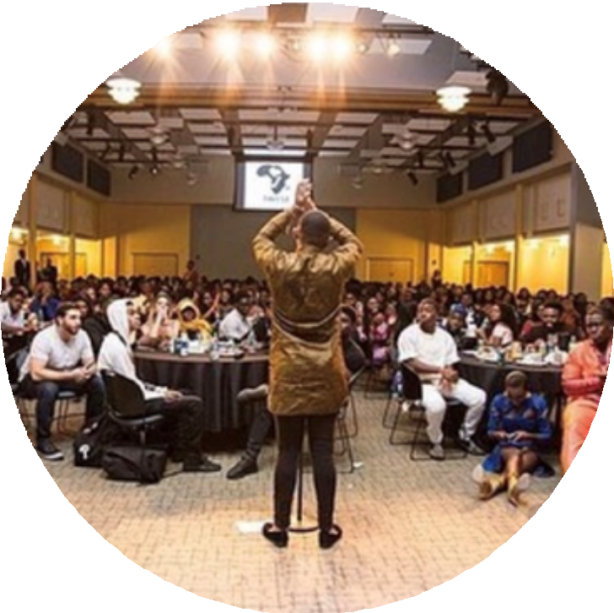

1) Banquet
Aids in showcasing African Culture
Each fall semester, we host a banquet to celebrate the greatness that the Twese organization has brought to the Rutgers community.
Anticipated Date : November 6, 2021
We have guest performances, which includes professors, students, and even Rutgers alumni to join us in our celebration in honoring Africa and African culture.
Our annual banquet is always open to everyone in the Rutgers community, including family and friends.

Slide 3
Costs &Funding
Expense Distribution | Cost
Advertising | $300
Room Rental | $400
Entertainment | $700 (DJ) $600 (Photography) $500 (host) $4000 (Performers) $600(Videographer)
Cultural Food | $3000
Decorations | $4000
Costumes/Props | $1500 (TDT Costume)
Other (Explain) | Makeup Artists $1000 Fabric: $600 Tailors: $4000
TOTAL PROGRAM COST: | $21,200

